Slide 1

KGiSL INSTITUTE OF TECHNOLOGY
COIMBATORE
DEPARTMENT OF computer science & engineering
Project phase review
KOVAI SPOT BUS – BUS RECOMMENDATION SYSTEM
Team Members:
711719104058 Niranjan E
711719104083 Sasi Keerthana R
711719104084 Sasi Kumar P
711719104101 Tharini M
Under the guidance of :
Ms. Aruna T N, AP/CSE

Slide 2

agenda
Abstract
Existing System
Literature Survey
Proposed System
Module Split-up
Expected Outcome
References
Timeline

Slide 3
abstract
To create an application that informs bus schedules and their route details for public people. This application reduces the manual errors involved in travel process and make it convenient to the people. User need to give the details of source and destination accordingly it will display the bus number and routes. Users are able to search the arrival of buses with accurate information. This application reduces the waiting time of people for the buses and improving overall public transportation efficiency.

Slide 4
EXISTING SYSTEM
In TNSTC official application, there is no updation of records and not working properly.
There is no adequate system for a local bus service that keep records of distinct bus numbers and bus schedules.
There is no exact information about the buses and this system is not up to date so that it leads to people wastage of money and time.
DRAWBACKS
No proper validations and it does not have any manual monitoring.
Time consuming and no reliability.

Slide 5
literature survey
S.No | Published Year | Paper Title | Authors | Description
1 | 2021 | Active Bus Tracking & Bus Recommendation System | Amrita P Unnithan, Asiya Abu, Sumo Mariyam Mathew, Simi | The bus corporations provide bus timetables on the website.
2 | 2020 | Application-based bus tracking system | Shubham Jain | In this system, GPS tracking application which would be able to track school buses more accurately.
3 | 2020 | Intelligent Bus Monitoring and Management System | M. A. Hannan, A.M. Mustapha, A.Hussain and H. Basri | In this system, radio frequency identification (RFID) and integrated sensing technologies such as global positioning system (GPS).

Slide 6
S.No | Published Year | Paper Title | Authors | Description
4 | 2019 | Real Time Bus Tracking System | Manini Kumbhar, Meghana Survase, Pratibha Salunk | The application allow the users to search the bus which they want through bus numbers and will show the live location of the bus.
5 | 2018 | Bus Tracking System based on Location-Aware Services. | Priyanka V. Narkhedeal | In this smart bus tracking system that any passenger with a smart phone.

Slide 7
PROPOSED SYSTEM
This system allows the users to easily access up-to-date bus number and timing information. If there is any changes in the schedules, admin can update the schedules.
Users should be able to easily search for bus routes, stops and view information such as the next bus arrival time and any delays or changes to the schedule.
ADVANTAGES
It reduces waiting time and improving overall public transportation efficiency.
This system allows manual monitoring.
This system provides searching facilities for new peoples.

Slide 8
MODULES SPLITUP
Module 1: Admin Authentication
Module 2: Add Route Information
Module 3: Search Route
Module 4: Bus Location Update

Slide 9
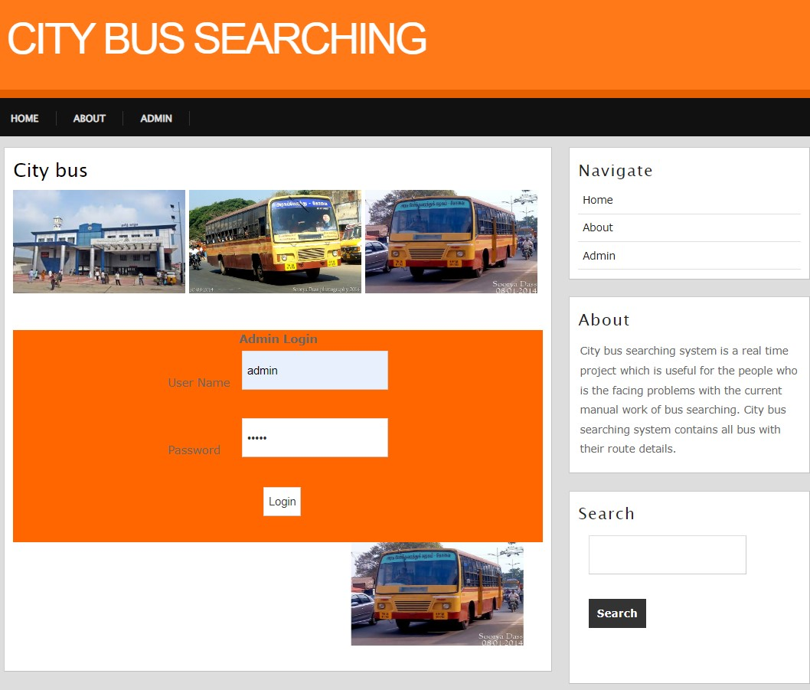
ADMIN AUTHENTICATION

Slide 10
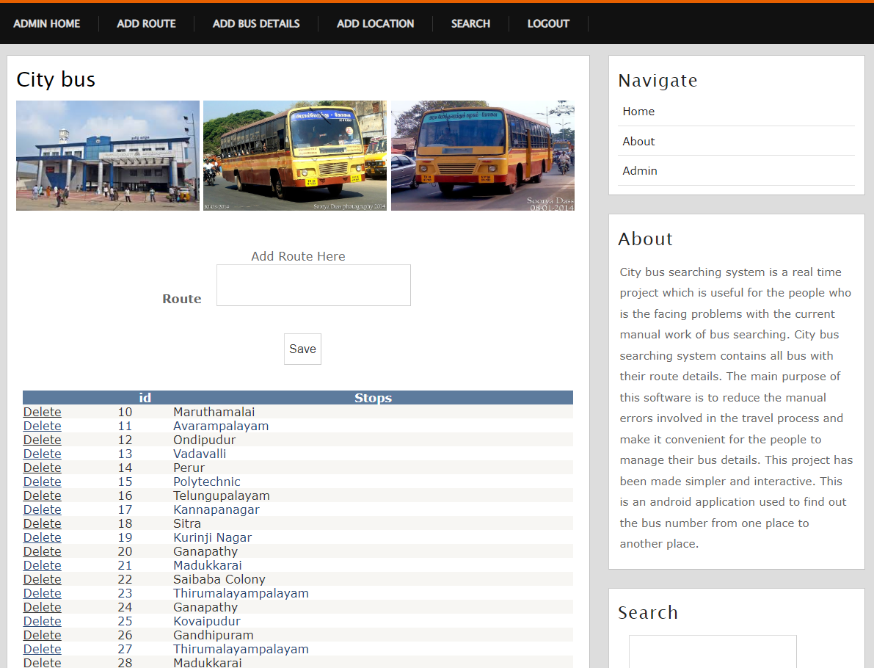
ROUTE INFORMATION

Slide 11
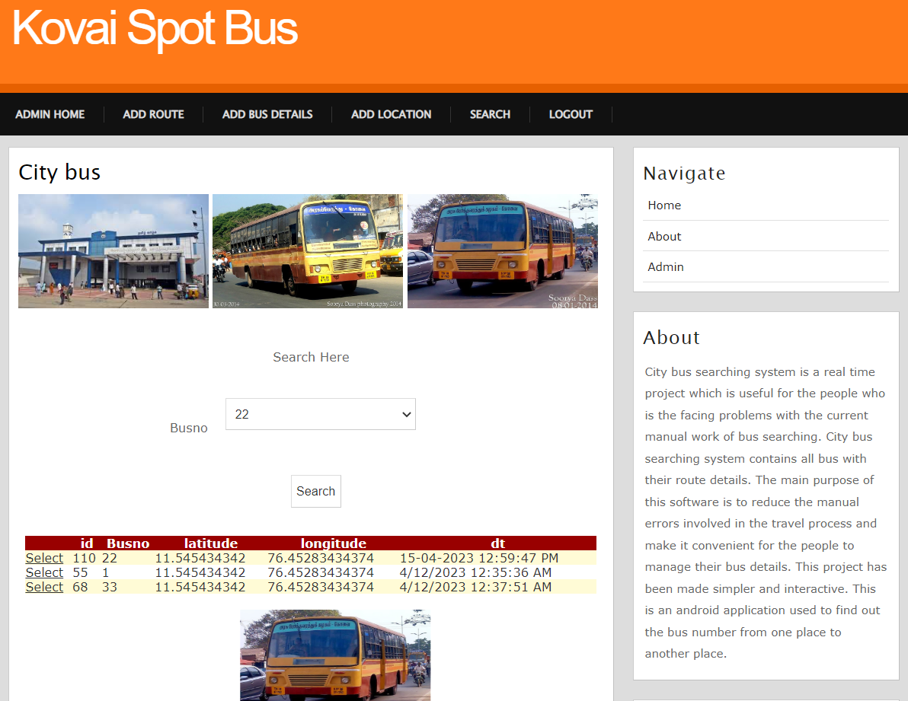
SEARCH ROUTE

Slide 12
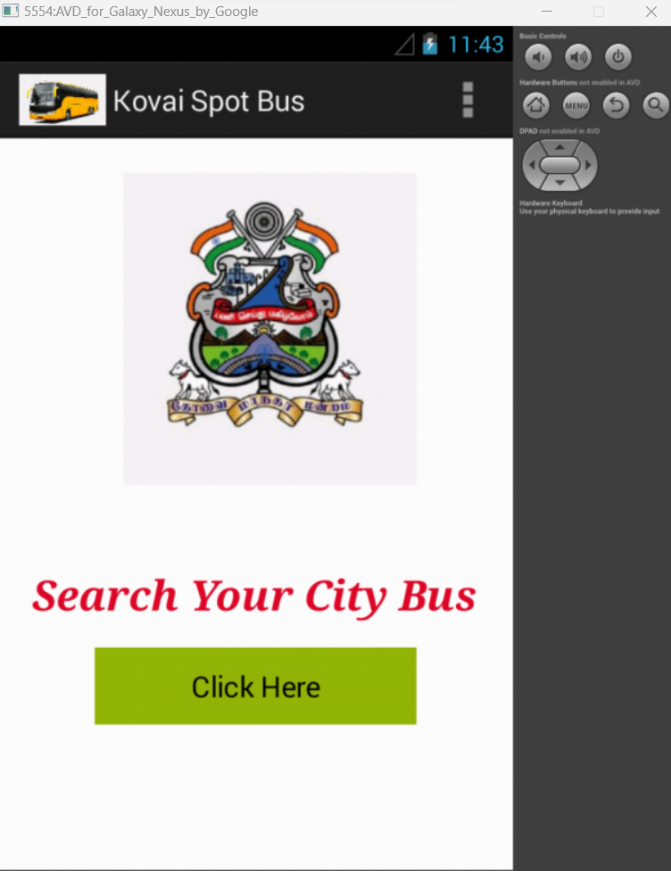
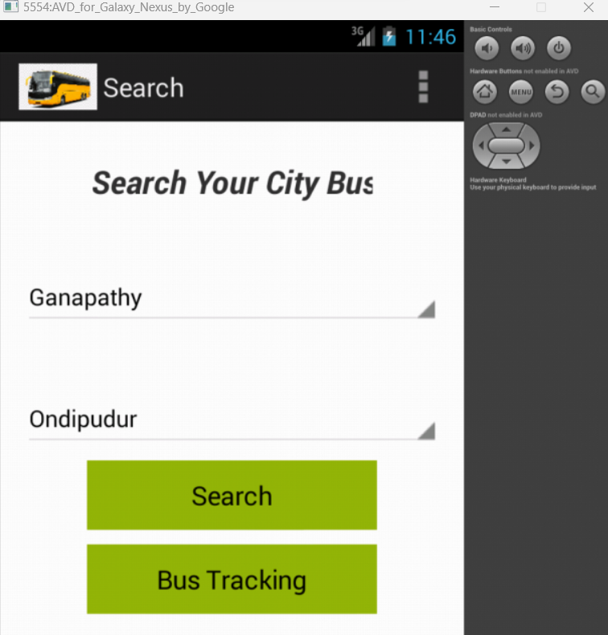
SEARCH ROUTE

Slide 13
EXPECTED OUTCOME
This applications informs more accurate information of bus schedules and bus numbers for people by local bus service.
This system helps to increase overall ridership and encourage more people to use public transportation. Users can plan their trips more efficiently and reducing waiting time.
Users can select source and destination, it displays bus numbers along with their routes.

Slide 14
REFERENCEs
[1] Grava S, Urban Transportation System(2020) McGraw-Hill Professional.
[2] Sun C W. Zhou and Y. Wang, Scheduling Combination and Headway Optimization of Bus Rapid Transit. Journal of Transportation Systems Engineering and Information Technology(2019).
[3] Van Oudheusden D.L and Zhu-Trip frequency scheduling for bus route management in Bangkok. European Journal of Operational Research 2020.
[4] Yan S and H.L Chen - A scheduling model and a solution algorithm for inter-city bus carriers. Transportation Research Part A: Policy and Practice, (2020).
[5] R.K Cheung and Y. Wan - Merging bus routes in Hong Kong's central business Analysis and models transportation Research (2020)

Slide 15
REFERENCEs
[6] Sarah Aimi Saad, Aisha Badrul Hisham, Mohamad Hafis - Real-time on-Campus Public Transportation Monitoring System (2020).
[7] Jerrin George James and Sreekumar Nair - Efficient Real time Tracking of Public Transport Using LoRaWAN and RF Transceivers (2021).
[8] Darshan Ingle and A. B. Bagwan – Real Time Analysis and Simulation of Efficient Bus Monitoring System (2022)
[9] Swati Chandurkar, Sneha Mugade - Implementation of Real Time Bus Monitoring and Passenger Information System(2019)
[10] Ramesh Chandra Gadri "Land Vehicle Tracking Application on Android Platform” - 2019

Slide 16
TIMELINE
Particulars | Feb-23 |  |  |  | Mar-23 |  |  |  | Apr-23 |  |  |  | May-22
 | Wk1 | Wk2 | Wk3 | Wk4 | Wk1 | Wk2 | Wk3 | Wk4 | Wk1 | Wk2 | Wk3 | Wk4 | Wk1 | Wk2 | Wk3 | Wk4
Problem Identification
Literature Survey
Module 1
Module 2
Module 3
Testing
Thesis Draft
Final Thesis
Viva

Slide 17
THANK YOU

